Slide 1
Azure Migration Tools Deep-Dive and Roadmap
Mohamed Garrana

Slide 2
What’s Driving Migrations?
Software and hardware refresh
Security threats
Urgent capacity needs
Compliance
Quickly integrate acquisitions
Application innovation
Migration triggers
Software end of support
Datacenter contracts expiry

Slide 3




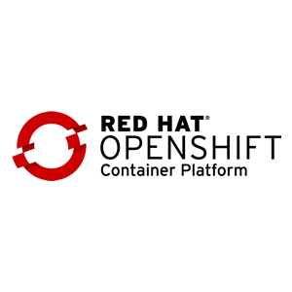



Azure Continues to Innovate
Azure Migrate to assess Windows and Linux VMs on VMware
Deep Java and Tomcat support in Azure App Service
Azure Database for PostgreSQL, MySQL, and MariaDB
Azure Site Recovery for Windows and Linux migration
Windows / Linux containers on Azure App Service, Kubernetes on Azure
Azure SQL Database Managed Instance
Azure Database Migration Service for SQL Server and My/ Postgre/No-SQL migration
Red Hat Enterprise Linux & Red Hat OpenShift
Cassandra and Mongo DB support in Azure Cosmos DB

Slide 4
Azure Migration Journey
Migrate*
Rehost
lift-and-shift
Refactor
Assess
Optimize
Rearchitect
Rebuild
*These migration strategies are adopted from Gartner research. Gartner also calls out a 5th strategy called “Replace” with SaaS

Slide 5
















Tools for Every Stage
Microsoft
Assess
Migrate
Optimize
Azure Migrate
Azure Site Recovery
Azure security and management (security, backup, monitoring, cost management)
Data Migration Assistant
Azure Database Migration Service
SQL Server Migration Assistant
Azure Data Box
Partners

Slide 6
Discover and Assess
with Azure Migrate

Slide 7


Azure Migrate for Discovery and Assessment
What does it do?
Easily discover on-premises VMs and applications, including application dependencies
Insightful workload assessments:
Right-sized Azure resources based on utilization history
Estimated monthly run costs in Azure
Migration risks and recommended tools
Roadmap
Hyper-V & physical server discovery and assessment
Built-in migration experience
Azure

Slide 8



How Azure Migrate Works
Raw metadata
Processed metadata
Appliance
HTTPS, 443
Azure Migrate Service
Assessment
2. Start discovery
3. Create assessment
Raw metadata
443
vCenter Server
1. Download and configure appliance
Customer
vSphere server and VMs
Documentation: http://aka.ms/azuremigrate/documentation
Videos: https://aka.ms/migrate/video

Slide 9

Light discovery
Appliance-based
No pre-setting or pre-configuring a machine
No installation of pre-requisite software
No agents to install and no firewall ports to open
No machine creds (host or guest)
No privileged creds (virtualization manager)
No waiting to gather performance history
Agent-based
No guesswork anymore
No need to remember which machine belongs to which app

Slide 10

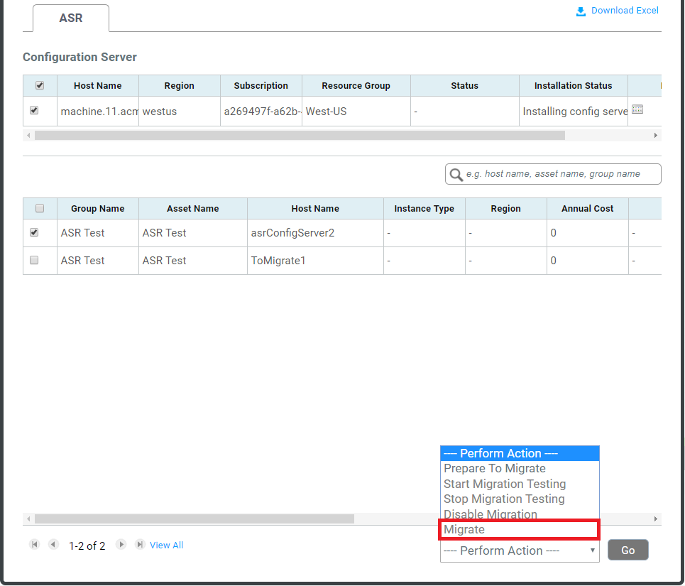
Migration to Azure with Cloudamize
Integration with ASR allows seamless migration via Cloudamize Platform
Download ASR Readiness Report to identify and reconcile potential blockers
Prepare infrastructure for ASR migration including setting up ASR configuration server and mobility service in just a few clicks
Execute tests and replication via the Cloudamize Platform and track migration status

Slide 11
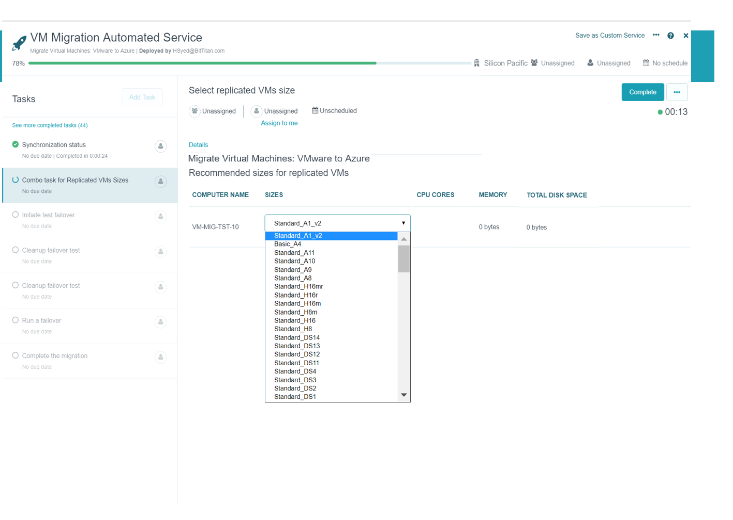
Migration to Azure with BitTitan
Support for discovery, assessment and planning using BitTitan capabilities
Prepare infrastructure for ASR migration including setting up ASR configuration server and mobility service in just a few clicks
Migration and cutover to Azure using Azure Site Recovery integration

Slide 12
Demo
Azure Migrate
Discovery, Assessment, Cost Planning

Slide 13
Recent Enhancements
Sizing | Target location Performance-based sizing ^{NEW} As on-premises sizing ^{NEW} Option to specify VM series ^{NEW} Option to specify storage type for Single VM SLA ^{NEW} Confidence rating
Cost estimation | Azure Hybrid Benefit Azure Offers Custom Discount Currency ^{NEW} Reserved Instances ^{NEW} VM uptime
Migration target locations | Azure commercial regions ^{NEW} Azure Government, Germany and China
Azure platform support | Managed Disk Up to 4TB data disk support ^{NEW} Windows Server 2008 (32 & 64-bit support)
Support Matrix
https://aka.ms/migrate/targetregions

Slide 14
Customer Considerations for Assessment Tools
Is the tool a Microsoft tool? More importantly, is there a free option?
Can I discover my infrastructure and perform assessments without installing an agent?
Can the same tool work for VMware, Hyper-V, physical servers, and more?
Can the tool find my application dependencies and group them?
Can the tool connect to other inventory sources such as Active Directory or CMDBs?

Slide 15
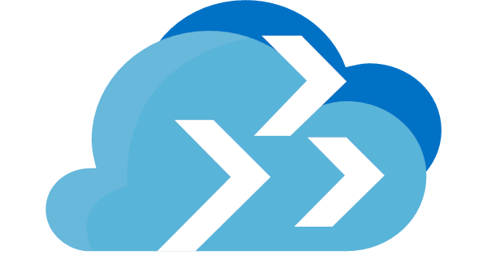

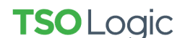


Customer Considerations for Assessment Tools
Microsoft tool – free option
Agentless discovery and assessments
Heterogenous (VMware, Hyper-V & physical servers)
Application dependency mapping
Import from CMDB and other sources
Azure Migrate
Azure Migrate
Azure Migrate
Tools listed are recommendations, but not an exhaustive list.
See azure.com/migration/partners for the full list.

Slide 16




Choosing Between Microsoft and ISV Tools
Use Azure Migrate when customer needs…
Use ISV tools when customer needs…
A Microsoft Azure branded tool which is free
Assessment of heterogeneous environments
(physical, VMware and Hyper-V)
Assessment of VMware environments¹
Agentless dependency visualization
Assessments of brand new Azure platform functionality
¹ Support for Hyper-V and physical servers is coming soon
Tools listed are recommendations, but not an exhaustive list.
See azure.com/migration/partners for full list.

Slide 17



Assessment Tools Comparison
Criteria
Free
Agentless data collection
Support for VMware
Support for Hyper-V | Coming soon
Support for Physical servers | Coming soon
Dependency visualization |  |  |  | leverages 3rd-party tools
Right-sizing and cost estimation
Agentless dependency visualization
Reserved instance-based pricing
Granular cost analysis
Support for new Azure SKUs as they roll out
Azure Migrate

Slide 18
Migrate VMs and Servers
with Azure Site Recovery

Slide 19
Azure Site Recovery for Server Migration
What does it do?
Effortless migration of VMs and apps to Azure
Zero application data loss during migration
Near-zero application downtime during migration
Broad coverage for hypervisors, applications, operating systems, and Azure features
No-impact application testing in Azure
Free usage during migration
Roadmap
OS-agnostic, agentless migrations to Azure
Integration with discovery and assessment
Azure

Slide 20







How Hyper-V Migration Works
443 (HTTPS)
Microsoft Azure
Data Channel
Public Internet or ExpressRoute with Public Peering
Source: Hyper-V
Microsoft Azure Recovery Services Agent
Replicates data to Azure
Documentation: https://aka.ms/asr_hyperv
Videos: https://aka.ms/asr_videos

Slide 21





How VMware Migration Works
Config Server
Process Server
443 (HTTPS)
9443 (HTTPS)
Microsoft Azure
443 (HTTPS)
Microsoft Azure
Data Channel
Public Internet or ExpressRoute with Public Peering
Source: VMware, AWS, Physical Servers
Process Server
Used for caching, compression, and encryption
Configuration Server
Used for centralized management
Mobility Service Captures all data writes from memory
Documentation: http://aka.ms/asr_vmware
Videos: https://aka.ms/asr_videos

Slide 22
Comprehensive Coverage for VMware
vCenter Server and vSphere support | 6.5, 6.0, ^{NEW}6.7, 5.5
Windows Guest OS support | Windows Server 2016 Windows Server 2012 R2 Windows Server 2012 Windows Server 2008 R2 ^{NEW} Windows Server 2008 (32-bit and 64-bit)
Linux Guest OS support | RHEL 5.*, 6.* and 7.* Cent OS 5.*, 6.* and 7.* Ubuntu 14.04 and 16.04 LTS ^{NEW} SUSE Enterprise Server 12 SP1, SP2, SP3 SUSE Enterprise Server 11 SP3, SP4, 12 SPI OEL 6.4 and 6.5 Debian 7 and 8 support
Azure platform support | Managed Disk Up to 4TB data disk support Encrypted Storage Azure Hybrid Benefit for Windows Server
Support Matrix
https://aka.ms/asr_supportmatrix
NOTE: Hyper-V Migration with Azure Site Recovery supports every Windows and Linux OS that is endorsed to run on the Azure Compute platform

Slide 23



Zero Application Data Loss
Test Performance
Plan and Notify
Take App Offline
Migrate to Azure
Resume
App

Slide 24
Customer Considerations for Migration Tools
Is the tool a Microsoft tool? More importantly, is there a free option?
Can I migrate Windows and Linux servers to Azure?
Can the same tool work for VMware, Hyper-V, and physical servers?
Can I perform migrations without running an appliance in Azure?
Can I perform migrations without installing an agent on my servers?

Slide 25

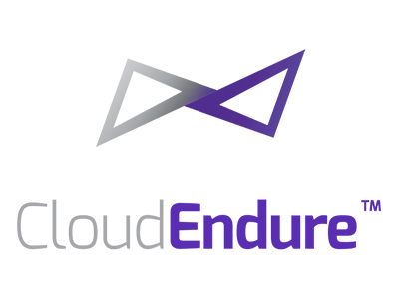

Customer Considerations for Migration Tools
Microsoft tool – free option
Windows and Linux
VMware, Hyper-V, physical servers
No appliance needed in Azure
No agent needed on servers
Azure Site Recovery
Azure Site Recovery
Azure Site Recovery
Azure Site Recovery
Tools listed are recommendations, but not an exhaustive list.
See azure.com/migration/partners for the full list.

Slide 26


Choosing Between Microsoft and ISV Tools
Use Azure Site Recovery (ASR) when customer needs…
Use ISV tools when customer needs…
A Microsoft Azure branded tool which is free
OS-agnostic coverage
Migration of Windows and Linux workloads
(covering most versions and distros)
Agentless migration solution
Support for new Azure SKUs as they roll out
Tools listed are recommendations, but not an exhaustive list.
See azure.com/migration/partners for full list.

Slide 27

Migration Tools Comparison
Criteria
Free
Agentless migration solution | Coming soon
Support for VMware
Support for Hyper-V
Support for Physical servers
OS-agnostic coverage | Coming soon
No replication server needed in Azure
Support for new Azure SKUs as they roll out

Slide 28
ASR deployment Planner for Hyper-v
VM eligibility assessment, based on the number of disks, disk size, IOPS, churn, and a few VM characteristics
Network bandwidth need versus RPO assessment
Azure infrastructure requirements
On-premises infrastructure requirements
Initial replication batching guidance
Estimated total disaster recovery cost to Azure

Slide 29
ASR Deployment Planner
Site Recovery Deployment Planner is a command-line tool for both Hyper-V to Azure and VMware to Azure disaster recovery scenarios.
Get the Virtual machine list
Profile
Generate a Report
Get throughput

Slide 30
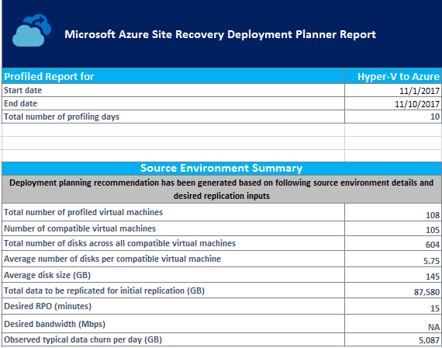
ASR Deployment Planner

Slide 31
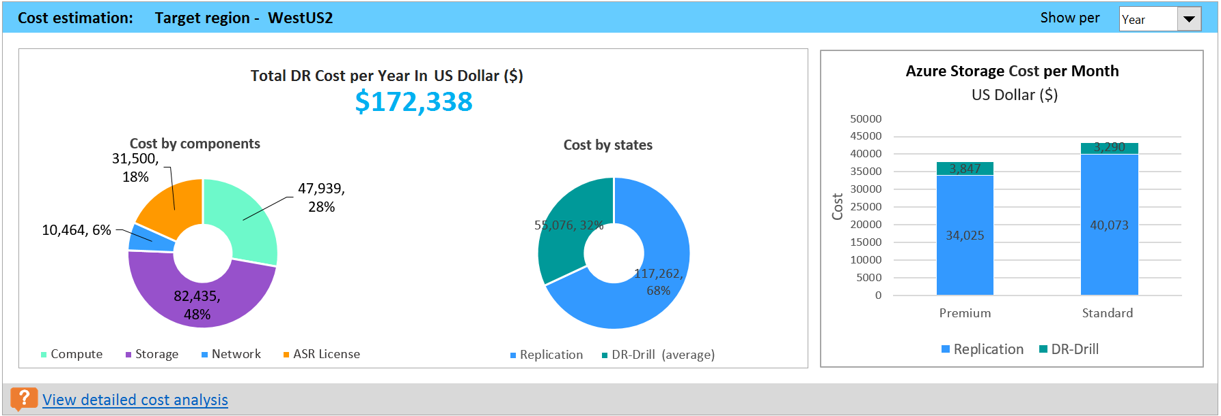
ASR Deployment Planner

Slide 32
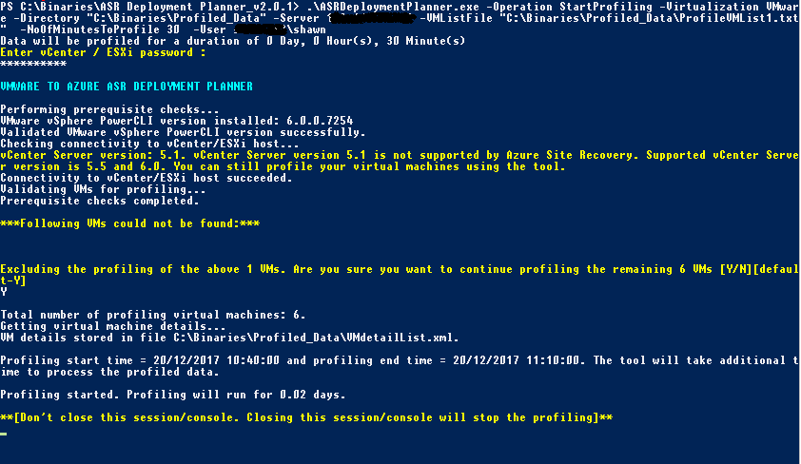
ASR Deployment Planner

Slide 33
Microsoft Assessment and planning tool kit https://www.microsoft.com/en-us/download/details.aspx?id=7826
MAP Toolkit

